Slide 1

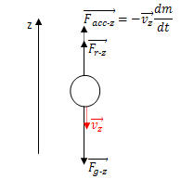
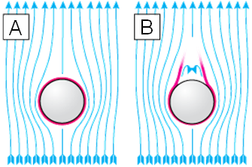

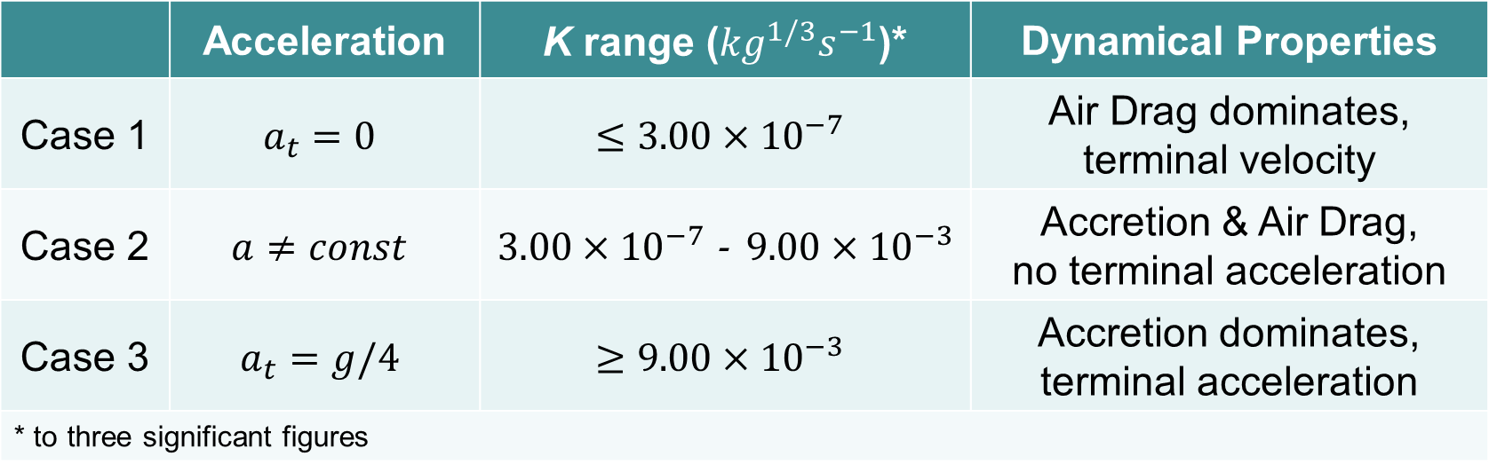
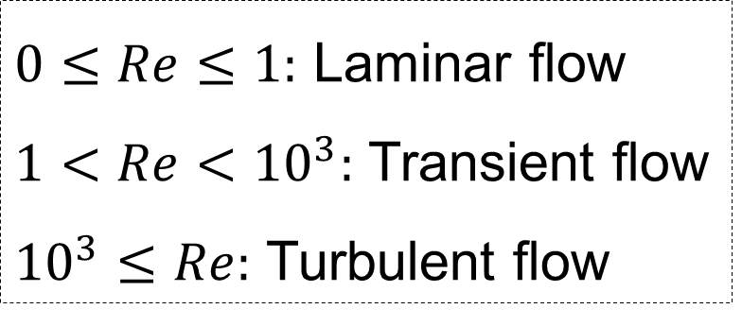
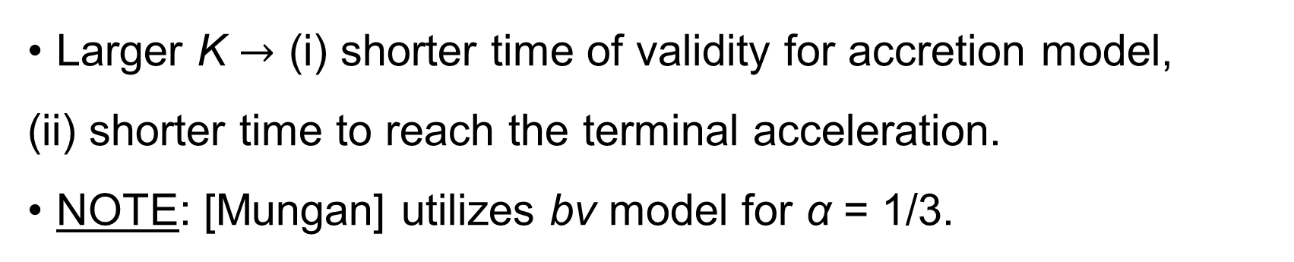




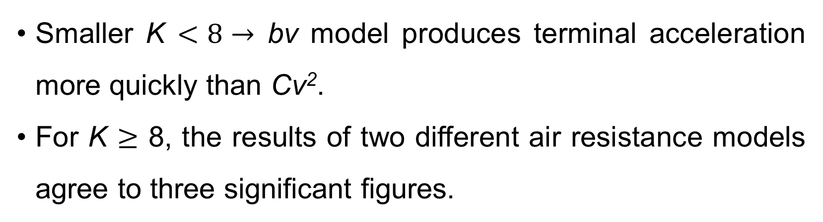
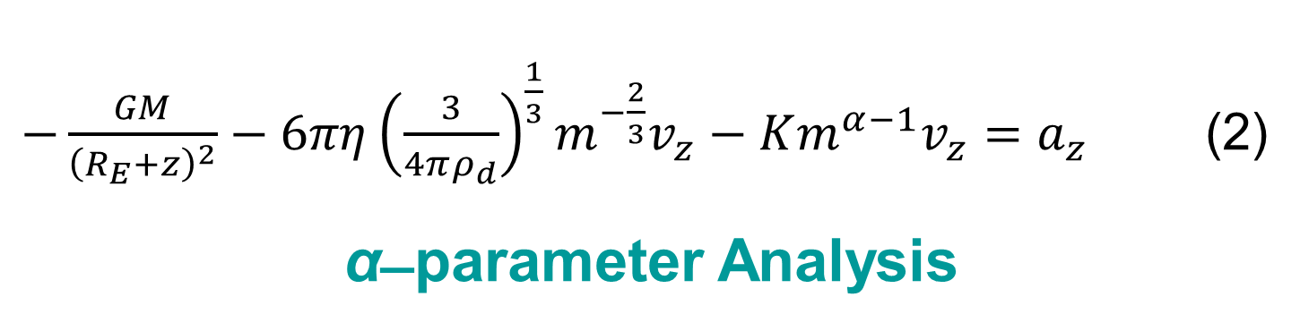
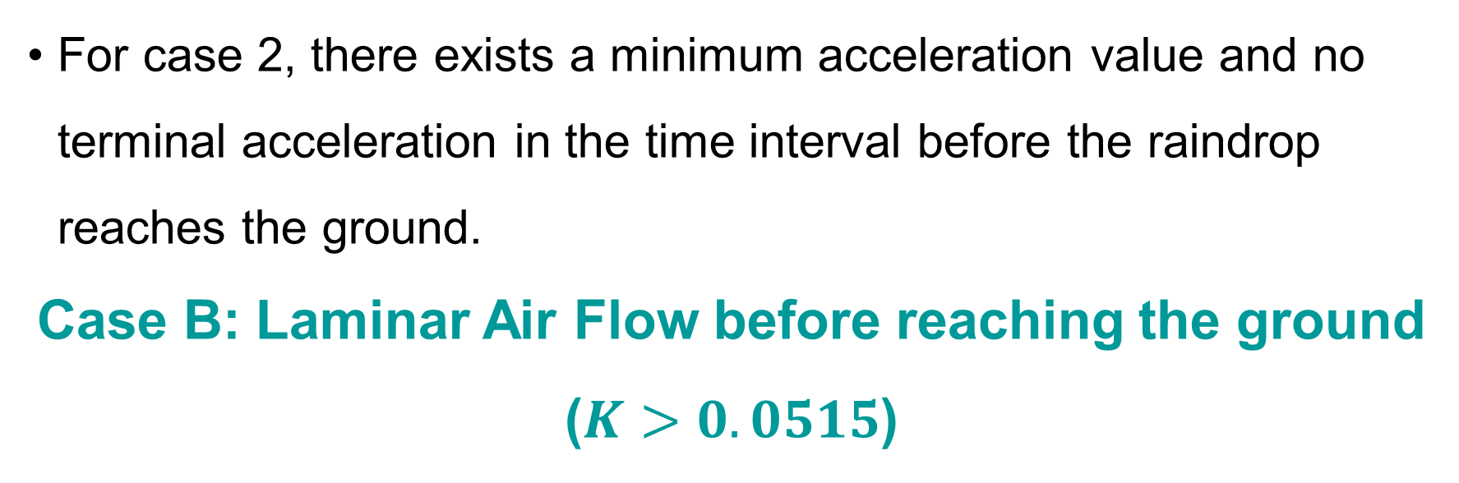
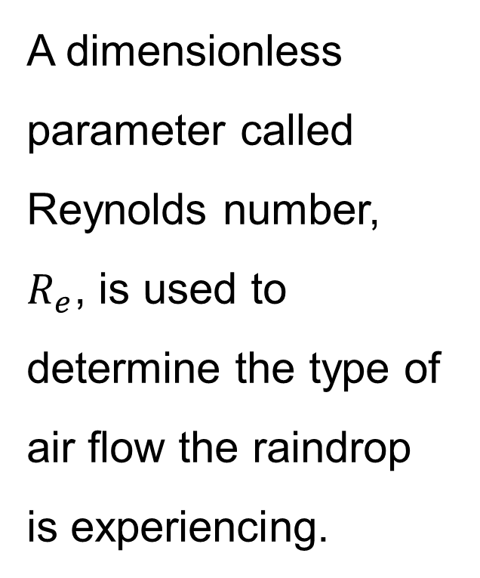


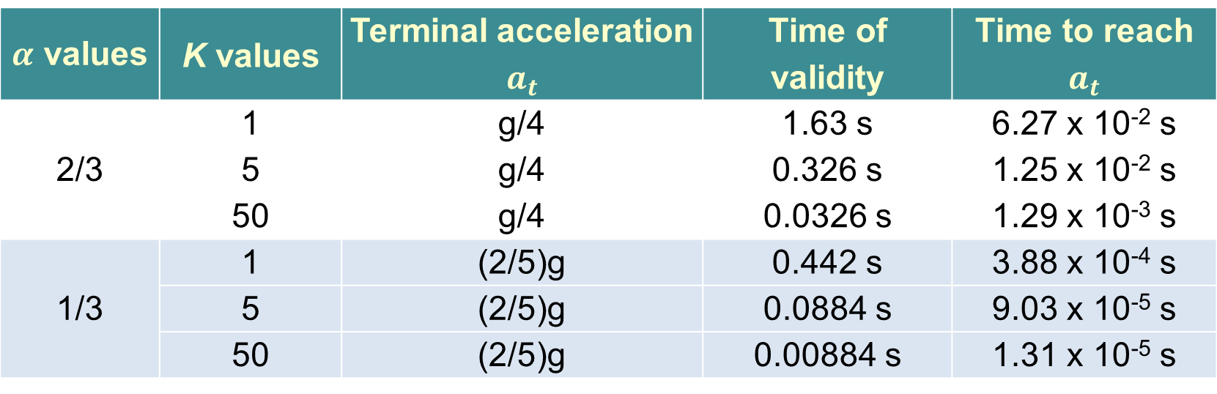
An Accretion Model for a Falling Raindrop
Ngan Le
Advisor: Dr. Eugene Li
Montgomery College
The Raindrop Problem
Air Resistance, Gravity, and Accretion Models
What About “Cv²” ?
The raindrop accretion problem is a mechanics problem which involves a raindrop gaining mass as it falls through a cloud of droplets in a non-uniform gravitational field according to Newton’s Inverse Square law for gravity. Effect of air resistance is also investigated.
Using numerical methods, we are able to predict the existence of terminal velocity and nearly terminal acceleration of the falling raindrop. This mathematical model of falling raindrops proposes a relationship to rocket problem which is considered a reversed process.
Dynamical Analysis with “bv” Air Drag
The dynamical differential equation based upon Newton’s 2nd Law is as follows
Case A: Laminar Air Flow during the entire motion
($K≤0.0515$)
  For the case when α = 2/3 and quadratic drag, dynamical differential equation is as follows:
$−\frac{GM}{{\left(R_{E}+z\right)}^{2}}+\frac{1}{2}ρ_{a}C_{r}π{\left(\frac{3}{4πρ_{d}}\right)}^{\frac{2}{3}}m^{−1/3}{v_{z}}^{2} −v_{z}Km^{−1/3}=a_{z}$
Compare solution curves with “bv” case:
$\sum{F_{z}}=\frac{dp_{z}}{dt}$ where $p_{z}=mv_{z}$
$$F_{g−z}+F_{r−z}−v_{z}\frac{dm}{dt}=ma_{z}$$
$$−\frac{GMm}{{\left(R_{E}+z\right)}^{2}}−(6πηr)v_{z}−v_{z}Km^{α}=ma_{z}$$
$−\frac{GM}{{\left(R_{E}+z\right)}^{2}}−6πη{\left(\frac{3}{4πρ_{d}}\right)}^{\frac{1}{3}}m^{−\frac{2}{3}}v_{z}−Km^{α−1}v_{z}=a_{z}$ (2)
α ̶ parameter Analysis
Effect of Air Flow
 | Acceleration | K range (${kg}^{1/3}s^{−1}$)* | Dynamical Properties
Case 1 | $$a_{t}=0$$ | $$≤3.00×{10}^{−7}$$ | Air Drag dominates, terminal velocity
Case 2 | $$a≠const$$ | $3.00×{10}^{−7}$ - $9.00×{10}^{−3}$ | Accretion & Air Drag, no terminal acceleration
Case 3 | $$a_{t}=g/4$$ | $$≥9.00×{10}^{−3}$$ | Accretion dominates, terminal acceleration
* to three significant figures
A dimensionless parameter called Reynolds number, $R_{e}$, is used to determine the type of air flow the raindrop is experiencing.
Smaller K $<8→$ bv model produces terminal acceleration more quickly than Cv².
For K $≥$ 8, the results of two different air resistance models agree to three significant figures.
For case 2, there exists a minimum acceleration value and no terminal acceleration in the time interval before the raindrop reaches the ground.
Case B: Laminar Air Flow before reaching the ground
($K>0.0515$)
Conclusions
Laminar air flow
Turbulent air flow
For example, for K = 1 shown above, the initial acceleration is close to free fall acceleration because the raindrop has nonzero initial mass. This result is valid for every K, and is independent of the α value.
Velocity becomes linearly dependent on time, so there exists a terminal acceleration to 3 significant figures.
α is a fitting parameter for constant acceleration value.
Larger α $→$ (i) smaller terminal acceleration, (ii) longer time of validity for accretion model, (iii) longer time to reach the terminal acceleration.
K ̶ parameter Analysis
According to equation (1), the K parameter determines the range of validity for laminar air flow model $0≤t≤\frac{{0.160}^{1−α}}{\left(1−α\right)K}$
$$K_{0}=\frac{{0.160}^{1−α}}{\left(1−α\right)t_{ground}}$$
K₀ is the largest value of K for which the raindrop experiences laminar air flow during its entire motion.
NOTE: α = 2/3 corresponds to a value $a$= g/4 as in [Krane] NOTE: For free fall case, $t_{ground}=31.6 s$ yields $K_{0}=0.0515$.
1. In the case of laminar air resistance, accretion model parameters affect the dynamics.
α parameter accounts for a terminal acceleration value
Both α and K parameters account for the time to reach terminal acceleration and the time interval at terminal acceleration before reaching the ground
2. A realistic value of acceleration, e.g. 10⁻³ g, can be achieved by selecting α value close to the upper bound, e.g. 0.999.
3. For K < 8, terminal acceleration can be accounted for by the bv model.
4. Our raindrop model is appropriate for the rocket problem since the initial mass is nonzero and the gravitational force is proportional to 1/r². Equation (2) for the rocket becomes
$$−\frac{GM}{{\left(R_{E}+z\right)}^{2}}−6πη{\left(\frac{3}{4πρ_{d}}\right)}^{\frac{1}{3}}m^{−\frac{2}{3}}v_{z}−Km^{α−1}v_{z−rel}=a_{z}$$
where $v_{z−rel}=v_{z}−v_{exhaust}$
$R_{e}$ is defined as the ratio of inertial force to viscous force per unit mass. In case of a sphere:
where $η$ = viscosity of the atmosphere = $1.81×{10}^{−5}{kg}/{m∙s}$ and
$ρ_{a}$= air mass density $≈1.225{kg}/{m^{3}}.$
Consider a spherical raindrop with radius, $r≤3.81×{10}^{−5}$ m, is falling at slow speed, $v≤0.188$ m/s. The raindrop experiences laminar air flow, because
$$R_{e}=\frac{2rρ_{a}v}{η}≤\frac{2×3.81×{10}^{−5}×1.28×0.188}{1.81×{10}^{−5}}≈0.994<1$$
  Models
  Mass of spherical raindrop: $m=\frac{4}{3}πρ_{d}r^{3}$
  Non-uniform gravitational force: $F_{g−z}=−G\frac{Mm}{{\left(R_{E}+z\right)}^{2}}$
  Stoke’s air resistance: $F_{r−z}=−bv_{z}=−\left(6πηr\right)v_{z}$
  Accretion model: $\frac{dm}{dt}=Km^{α}$, $0<α<1$ (1)
  $where K$ is accretion model parameter with units ${kg}^{1−α}s^{−1}$.
$0≤Re≤1:$ Laminar flow
$1<Re<{10}^{3}:$ Transient flow
${10}^{3}≤Re:$ Turbulent flow
$$R_{e}=\frac{2rρ_{a}v}{η}$$
$α$ values | K values | Terminal acceleration $a_{t}$ | Time of validity | Time to reach $a_{t}$
2/3 | 1 | g/4 | 1.63 s | 6.27 x 10⁻² s
 | 5 | g/4 | 0.326 s | 1.25 x 10⁻² s
 | 50 | g/4 | 0.0326 s | 1.29 x 10⁻³ s
1/3 | 1 | (2/5)g | 0.442 s | 3.88 x 10⁻⁴ s
 | 5 | (2/5)g | 0.0884 s | 9.03 x 10⁻⁵ s
 | 50 | (2/5)g | 0.00884 s | 1.31 x 10⁻⁵ s
References
Larger K $→$ (i) shorter time of validity for accretion model,
(ii) shorter time to reach the terminal acceleration.
NOTE: [Mungan] utilizes bv model for α = 1/3.
Mungan, C.E., “More about the falling raindrop,” AM. J. Phys. 78 (12), Dec. 2010.
Krane, K.S., “The falling raindrop: Variations on a theme of Newton”, AM. J. Phys. 49(2), Feb. 1981.

